Slide 1
IT 1724 Geographical Information Systems
Prof. HKD Sarma
Department of IT, SMIT

Slide 2
OBJECTIVE: To introduce the concepts, principles and theories behind a Geographic Information System with emphasis on the nature of geographic information, data models and structures for storing geographic information; Geographic data input, data manipulation, and spatial analysis and modeling techniques are to be understood.
Text Book:
An Introduction to Geographical Information Systems, Ian Heywood, Sarah Cornelius, Steve Carver, 2010, Pearson Education.

Slide 3
What is spatial data ? →Spatial data, also known as geospatial data, is a term used to describe any data related to or containing information about a specific location on the Earth's surface.
→ Geographical Information Systems (GIS) and Geospatial Data are in the core of this study.

Slide 4
Need to Answer various Questions about….
Location…
Patterns…
Trends…
Conditions…

Slide 5
GIS is useful here…..
Location:
→ Where is the nearest book shops?
→ Where are stone age settlements located in Europe?
→ Where are areas of forestry in which Rudrakhs trees are found?
Patterns:
→ Where do high concentrations of students live in the city?
→ What is the flow of traffic along this motorway?
→ What is the distribution of crime incidents in New Delhi?

Slide 6
GIS is useful here…..
Trends:
→ How are patterns of retailing changing in response to the development of out-oft-town superstores?
→ Where have glaciers retreated in the European Alps?
→ Where have changes to the population of polar bears occurred?

Slide 7
GIS is useful here…..
Conditions:
→Where can I find holiday accommodation that is within 1 km of a wind surfing beach and accessible by public transport?
→ Where is there flat land within 500 m of a major highway?
→ Where are there over 1 00,000 potential customers within a 5 mile radius of a railway station?

Slide 8
Defining GIS
Definitions of GIS cover three main components:
→GIS is a computer system
→GIS uses spatially referenced or geographical data, and
→GIS carries out various management and analysis tasks on these data including their input and output.

Slide 9
Capabilities of well-designed GIS:
Quick and easy access to large volume of data
The ability to:
→select detail by area of theme
→link or merge one data set with another
→analyse spatial characteristics of data
→search for particular features in an area
→update data quickly and cheaply
→model data
3. Output capabilities tailored to meet particular needs.

Slide 10
Components of a GIS:
→ Computer systems and software
[High power processor/sufficient memory/high resolution colour graphics screen/data input and output devices.]
→Spatial data
→Data management and analysis procedure
→People / Organizations

Slide 11
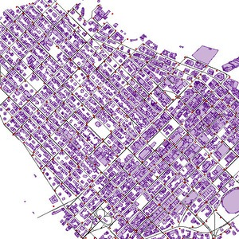
Spatial Data: Maps and their influence

Slide 12
Vector
Vector data is best described as graphical representations of the real world. There are three main types of vector data: points, lines, and polygons. Connecting points create lines, and connecting lines that create an enclosed area create polygons.
Vectors are best used to present generalizations of objects or features on the Earth’s surface. Vector data and the file format known as shapefiles (.shp) are sometimes used interchangeably since vector data is most often stored in .shp files.

Slide 13
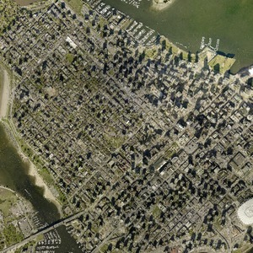
Raster data is data that is presented in a grid of pixels. Each pixel within a raster has a value, whether it be a colour or unit of measurement, to communicate information about the element in question. Rasters typically refer to imagery. However, in the spatial world, this may specifically refer to orthoimagery which are photos taken from satellites or other aerial devices. Raster data quality varies depending on resolution and your task at hand.

Slide 14
Spatial Data
Primary Data Sources
Daily Meteorological Records
Demand for skiing on different days of a week (no. of lift passes sold)
Secondary Data Sources
Meteorological Maps
Local Topographic Maps

Slide 15
Maps and their influence on the character of spatial data
Tasks of cartographer:
→Establish the purpose the map is to serve.
→Define the scale at which the map is to be produced
→Select the features (spatial entities) from the real world which are to be portrayed on the map.
→Choose a method for the representation of the features (points, lines, and areas).
→Generalize these features for representation in two dimensions.
→Adopt a map projection for placing these features onto a flat piece of paper.
→Apply a spatial referencing system to locate these features relative to each other.
→Annotate the map with keys, legends and text to facilitate use of the map.

Slide 16
Spatial Referencing
→A referencing system is used to locate a feature on the Earth’s surface or a two-dimensional representation of this surface such as a map.
→ Characteristics that a referencing system should have:
→ stability,
→ ability to show points, lines and areas,
→ ability to measure length, size (area) and shape.
CATEGORIES of Spatial Referencing:
→ Geographic co-ordinate systems
→ Rectangular co-ordinate systems
→ Non-co-ordinate systems

Slide 17
Geographic co-ordinate systems
→True geographic co-ordinates are latitude and longitude.
→ The location of any point on the Earth’s surface can be defined by a reference using latitude and longitude.
→ Lines of longitude (also known as meridians) start at one pole and radiate outward until they converge at the opposite pole.
→ Conceptually, they can be thought of as semicircles.
→ The arbitrary choice for a central line of longitude is that which runs through the Royal Observatory in Greenwich in England, and hence known as the Greenwich meridian or the prime meridian.

Slide 18
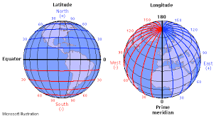
Longitude & Latitude

Slide 19
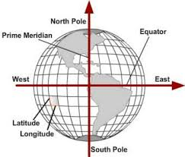
Longitude & Latitude

Slide 20
Geographic co-ordinate systems
→ Lines of longitude are widest apart at the equator, and closest together at the poles.
→ Lines of latitude lie at right angles to lines of longitude and run parallel to one another.
→ Each line of latitude represents a circle running around the globe.
→ Each circle will have a different circumference and area depending on where it lies relative to the two poles.
→ The circle with the greatest circumference is known as the equator (or central parallel), and lies equidistant from the two poles.

Slide 21
Geographic co-ordinate systems
→ Using lines of latitude and longitude, any point on Earth’s surface can be located by a reference given in degrees and minutes.
→ For example, the city of Moscow, represented as a point can be given a geographical reference using latitude and longitude of 55 degrees 45 minutes north (north of the equator) and 36 degrees 0 minutes east (east of the prime meridian).

Slide 22
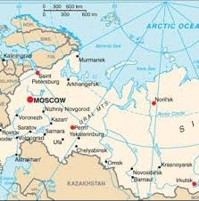
Geographic co-ordinate systems

Slide 23
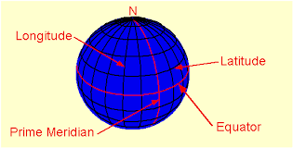
Longitude & Latitude

Slide 24
Spatial Referencing
→ A referencing system is used to locate a feature on the Earth’s surface or a two-dimensional representation of this surface such as a map.
Characteristics a referencing system should have:
→Stability,
→The ability to show points, lines and areas,
→The ability to measure length, size (area), and shape.
Categories of Spatial Referencing:
Geographic co-ordinate systems/Rectangular co-ordinate systems/ Non- co-ordinate systems

Slide 25
Spatial Referencing
→The Quaternary Triangular Mesh Referencing system (Goodchild and Yang, 1989) tries to deal with irregularities in the Earth’s surface.
→It replaces lines of latitude and longitude with a mesh of regular-shaped triangles.
→Each triangle occupies the same area on the Earth’s surface. The individual triangles are also of same size and shape.
→It can be moulded to fit the slight bumps and blemishes that the true surface of the Earth.

Slide 26
Spatial Referencing
The latitude and longitude referencing system assumes that the Earth is a perfect sphere. Unfortunately, that is not correct.
The Earth is actually an oblate spheroid somewhat like an orange with flatter poles and outward bulges in equatorial regions. Further, the surface of the Earth is far from smooth and regular.

Slide 27
Spatial Referencing
→At present, most of the spatial data available for use in GIS exist in two-dimensional form.
→In order to make use of these data a referencing system that uses rectangular co-ordinates is required.
→To obtain these a map graticule, or grid, is placed on top of the map.
→This graticule is obtained by projecting the lines of latitude or longitude from our representation of the world as a globe onto a flat surface using a map projection. The lines of latitude and longitude become the grid lines on a flat map.
→The problem is that when you project from a sphere onto a flat surface the image becomes distorted.

Slide 28
Spatial Referencing
→When small areas are being studied there will be only minor distortions in the layout of the grid.
→However, when large areas of the globe are projected onto a flat surface, the grid will tear and stretch.
→Therefore, all rectangular co-ordinate systems are designed to allow the mapping of specific geographical regions.
→A good example of rectangular co-ordinate system is the UK Ordnances Survey’s National Grid.

Slide 29
Spatial Referencing
→Non-co-ordinate system provides spatial references using descriptive code rather than co-ordinate. Postal codes, widely used throughout the world, are an example.
→Some postal codes are fully numeric, whilst some others are alphanumeric, as in the case of the UK postcode.
→Public Land Survey System (PLSS): used in western United States. There has been a recursive sub-division of the land into quarter sections. By knowing which section you are in, you can reference yourself to the Earth’s surface (DeMers, 2002).

Slide 30
Spatial Referencing
Some issues:
→Spatial entities may be mobile. Animals, cars and people move, therefore, any spatial reference they are tagged with will only represent their known location at a particular time.
→Spatial entities may change. Rivers meander, roads can be relocated and policy areas redefined.
→The same object may be referenced in different ways. House: point/area.
→Large number of different spatial referencing systems in use.

Slide 31
Topology
→In GIS, topology is the term used to describe the geometric characteristics of objects which do not change under transformations such as stretching or bending and are independent of any co-ordinate system (Bernhardsen, 1999).
→The topological characteristics of an object are also independent of scale of measurement (Chrisman, 2002).
→Topology, as relates to spatial data, consists of three elements: adjacency, containment, and connectivity.
→Adjacency and containment describe the geometric relationships that exist between area features. Area can be described being ‘adjacent’ when they share a boundary. Containment is an extension of the adjacency theme and describes area features that may be wholly contained within another area feature such as an island within a lake.

Slide 32
Topology
→Connectivity is a geometric property used to describe the linkages between line features. Roads are usually connected together to form a road network through which traffic can flow.
→An understanding of the geometric relationships between spatial entities is important for analysis and integration is GIS.
→Without knowledge of how entities are geometrically related to each other, it is impossible to answer questions like “What is the shortest route from A to B?”

Slide 33
Thematic Characteristics of Spatial Data
→On a nominal scale numbers are used to establish identity, e.g., telephone numbers. These numbers can not be processed mathematically.
→The numbers in an ordinal scale establish order. Ordinal scale is used to publish the top 10 cafes based on the number of people using them each week. Arithmetic operations are possible on ordinal data, but will give meaningless results.
→On an interval scale, the difference between numbers is meaningful, but the scale does not have a real origin.

Slide 34
Thematic Characteristics of Spatial Data
→Temperatures in degrees Celsius, are a good example of data that are collected using an interval scale. On a temperature scale it is possible to say that there is a 10 degree difference between a thermometer that records a value 10 degrees and one that records a value of 20 degrees. Thus differences can be calculated. However, it would be incorrect to say, that 20 degrees is twice as warm as 10 degrees, because zero degrees on the Celsius scale is not a true zero.
→Negative numbers are also possible on an interval scale.
→On a ratio scale, measurements can have an absolute or real zero, and the difference between the numbers is significant.

Slide 35
Other Sources of Spatial Data
Census and survey data:
→Population census, employment data, agriculture census data, or marketing data. (has a reference to location on the surface of the Earth)
Aerial Photographs:
→Aerial photography was the first method of terrestrial remote sensing. It is the capturing of images from a position above the Earth’s surface.
→Unlike a map, which is a model of the Earth’s surface and contains only a selection of data, an aerial photograph is a snapshot of the Earth at a particular instant in time.
Wide availability; low cost; wide area views; time-freezing ability; high spectral and spatial resolution; and three-dimensional perspective [Curran (1989) identified these six characteristics of aerial photographs]
Satellite Images:

Slide 36
GIS Data Standards
→Number of formats available for GIS data is almost as large as the number of GIS packages on the market.
BS 7666; CEN TC 287; DIGEST; DNF; GDF; GeoTIFF; GML; ISO 6709; ISO 8211; ISO 15046; NEN 1878; NTF; OGIS; RINEX; SDTS; UGDCS

